Slide 1
EDGE : BU-CSE
Digital Skill Trainning
EDGE:BU-CSE

Slide 2
Computer Fundamental & Office Application
Presented by
Johora Akther Jui
ID No : 003
Batch No : 68
Department of Chemistry
University of Barishal
Presented to :
Mahbub-E-Noor
Assistant Professor
Department of CSE
University of Barishal
EDGE:BU-CSE

Slide 3
Topic :
The Paint Industry
EDGE:BU-CSE

Slide 4
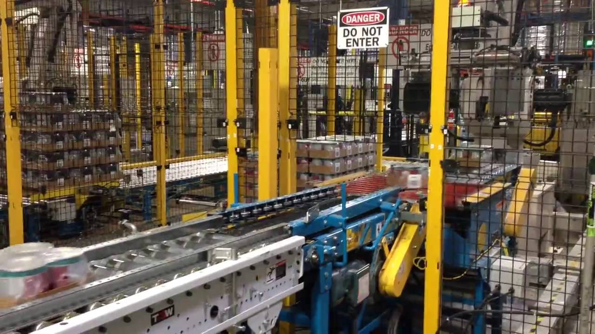
Introduction
EDGE:BU-CSE

Slide 5

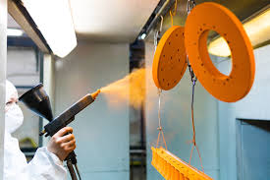
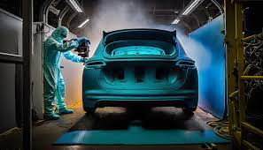

Key Segments of the Paint Industry
Architectural paints
Industrial coatings
Automotive Paints
Specialty Coatings
EDGE:BU-CSE

Slide 6
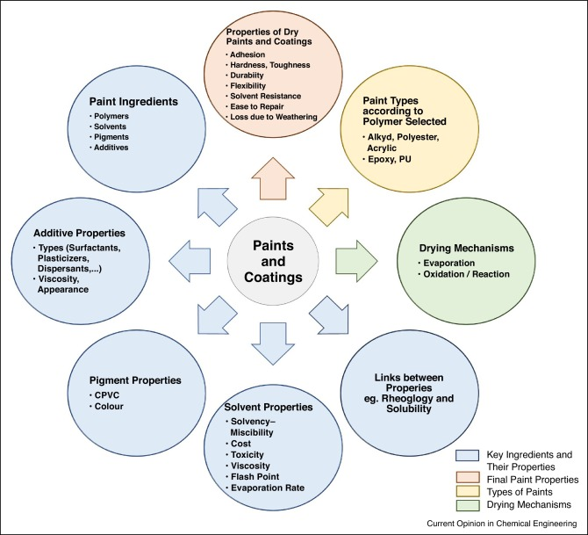
Types of Paints and Coatings
EDGE:BU-CSE

Slide 7

EDGE:BU-CSE

Slide 8
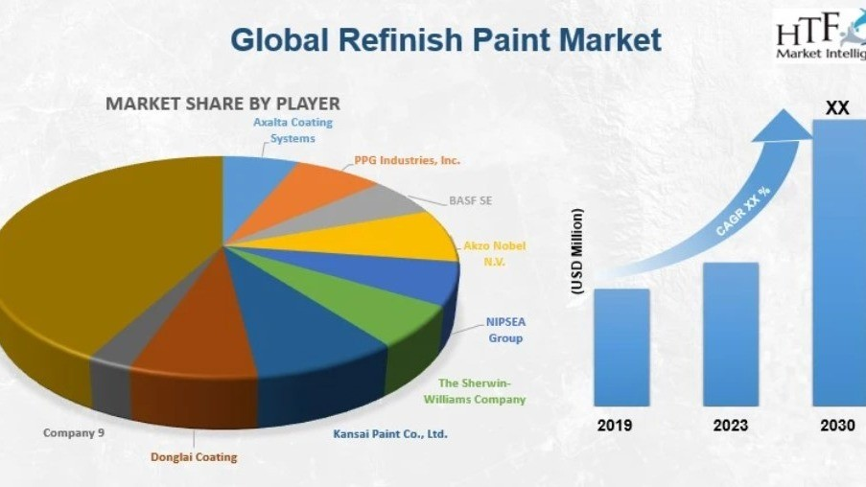
EDGE:BU-CSE

Slide 9
Thank you
EDGE:BU-CSE

